Slide 1
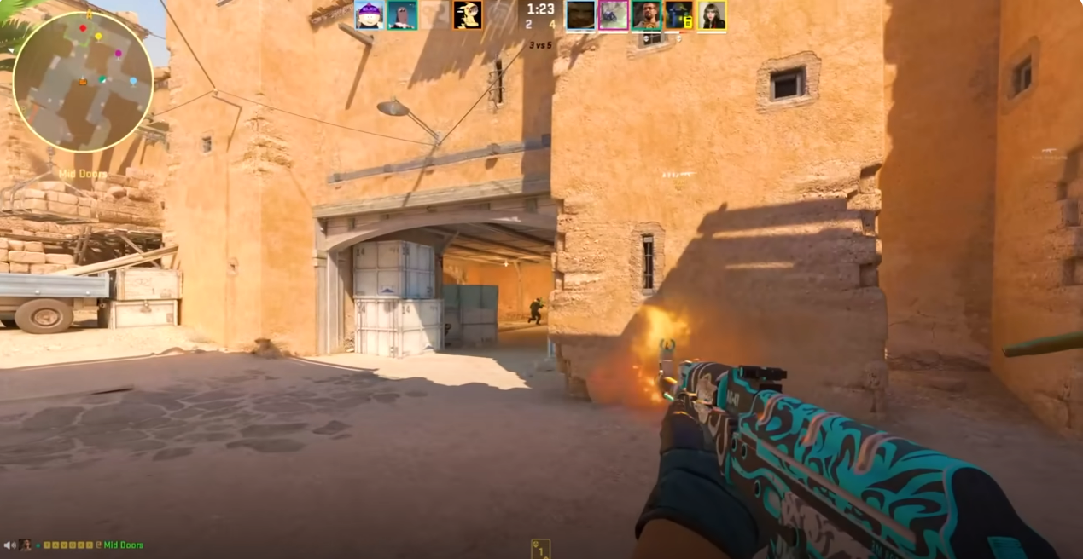
Cognitively stimulating leisure activities
Engagement in leisure activities contributes to a healthy lifestyle, but those with greater cognitive challenge show more potential for inducing cognitive improvements (von Bastian, Hyde & Jiang, 2023)
Notes:
Engagement in leisure activities is thought to contribute to a healthy lifestyle; however, not all activities are made equal, and those which involve a greater cognitive challenge show greater potential for improving cognition.
Video games are a highly popular and challenging leisure activity:
Screenshot from the video game we research, Counter-Strike which is a FPS game: typically featuring dynamic and complex environments which require players to make fast decisions or suffer in-game consequences.
Is there the potential for video games to benefit cognition?

Slide 2
Background
Bediou et al. (2018) found large effects for Action Video Game play on perception (processing speed), spatial cognition, top-down attention, and a medium effect for multitasking.
Bediou et al. (2023) replication finding the same as above, now a large main effect on multitasking.
Sala et al. (2018) found weak correlations between video game play and cognition.
Notes:
As I said earlier Bediou found robust effects of action video game play on cognition, specifically processing speed…
And a replication with improved methodology found the same except that the effect size for multitasking was now larger
Processing Speed and Multitasking is assumed to be important for FPS players who have to quickly process and accurately respond to multiple sources of visual information, switching between targets and other gameplay elements such as the mini-map, in-game chat and weapon-inventory.
Some inconsistent findings so far, which I have some possible explanations for which we wanted to address in our study.

Slide 3
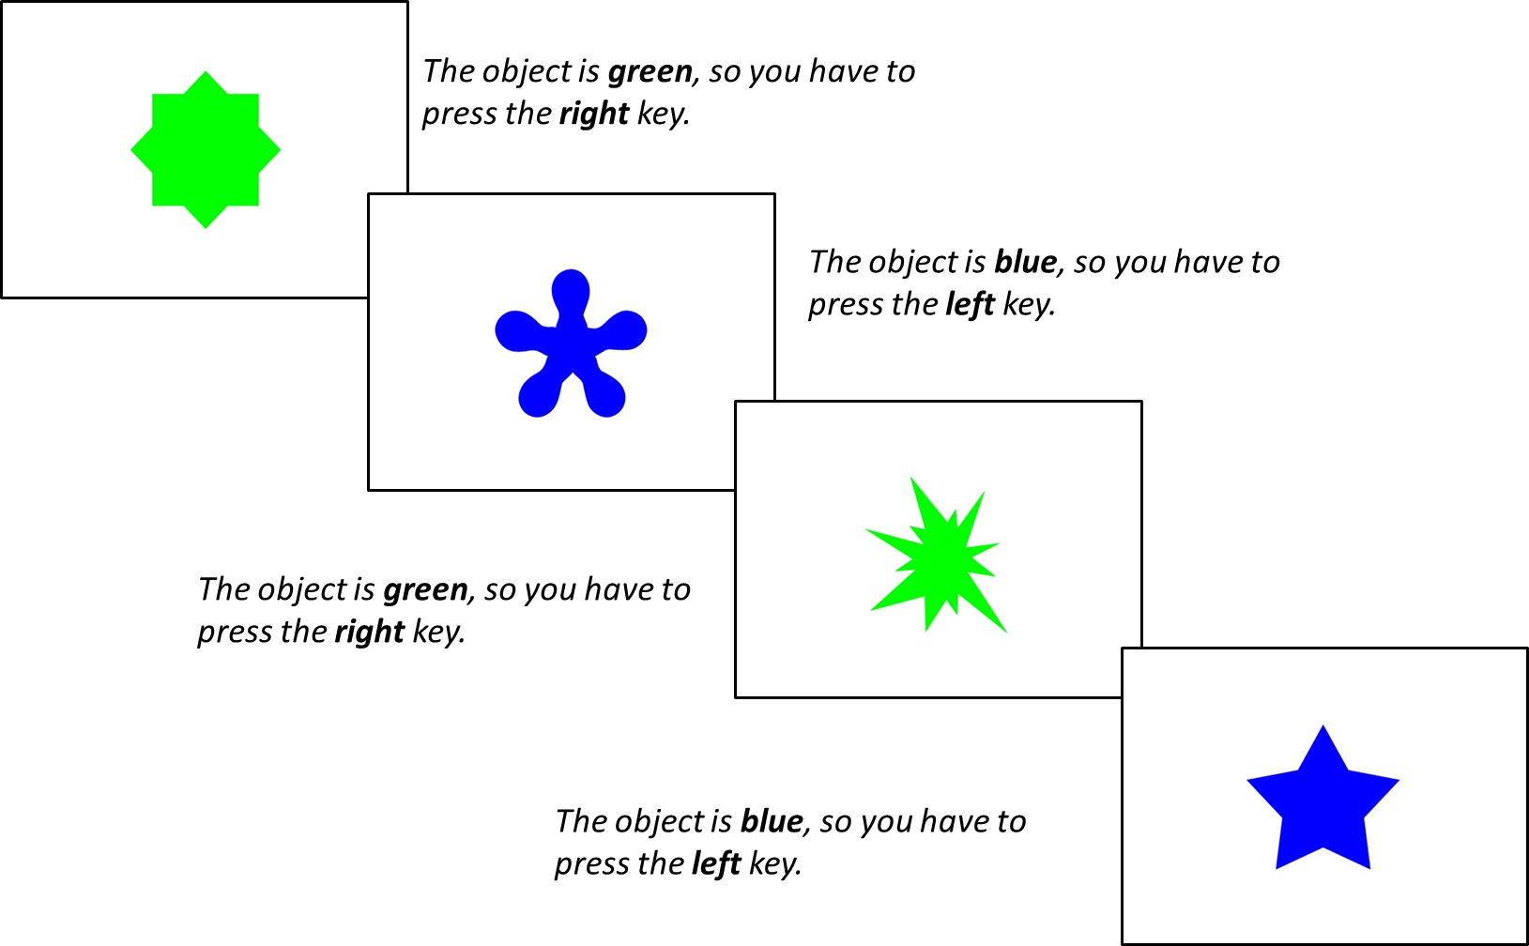
Method
Three Blocks:
Single-rule 1: 64 trials of shape followed by 64 trials of colour
Mixed-rule: 129 trials switching between shape and colour rule
Single-rule 2: 64 trials of colour followed by 64 trials of shape
n = 385
Within the Mixed-Rule Block:
Repetition trials: two successive trials in which the same rule is applied (shape + shape)
Switch trials: rule changed from the preceding trial to the current trial (shape + colour)
Choice Reaction Time Task

Slide 4
Method
Trial Types
Single trials
Repetition trials
Switch trials
Measures
RTs
Accuracy Score
Mixing Costs: RT performance cost of mixing two tasks (repetition trial RTs – single trial RTs)
Switching Costs: RT performance cost of switching from one task to another (switch trial RTs – repetition trial RTs)
Choice Reaction Time Task

Slide 5

Method
Choice Reaction Time Task
Pro
Expert
Casual
CS Questionnaire
Total hours of playtime
Weekly hours of playtime
Current Ranking in CS
Self-rated expertise

Slide 6
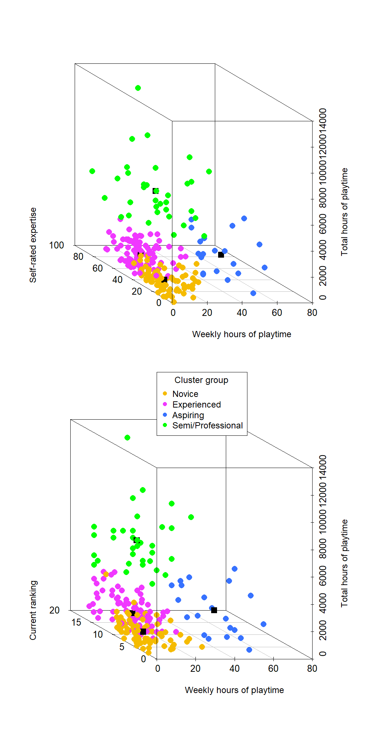
CS Expertise
N = 230
4 CS Expertise Measures
K-means cluster analysis (k = 4)
N = 77
N = 98
N = 21
N = 34
scatterplot3d function from the scatterplot3d package in R

Slide 7
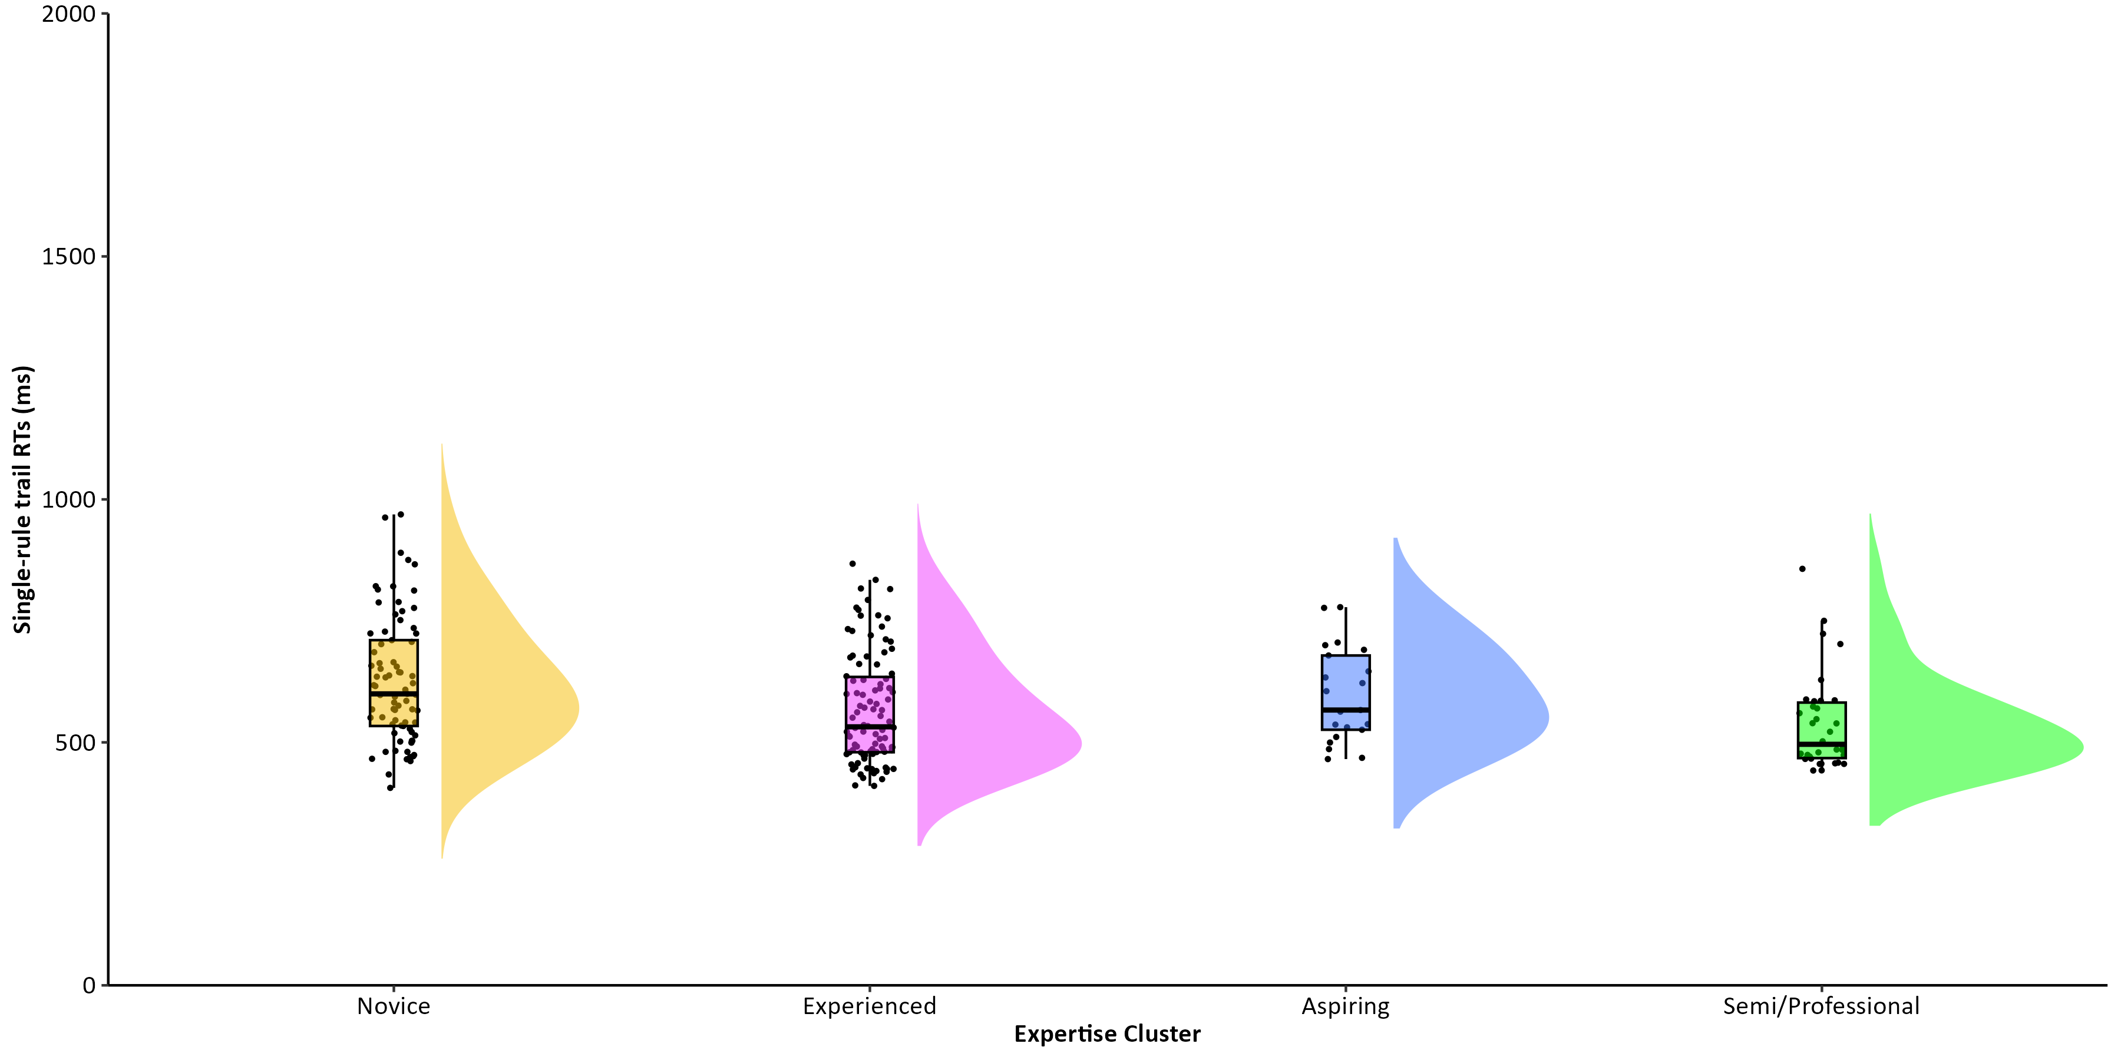
Single Trial RTs
Very strong evidence in favour of a main effect of expertise group on single trial RTs: BF = 50.40
M = 591, SD = 112
Notes:
Novice - Pro BF = 52.55
Novice - Exp B= 18.78

Slide 8
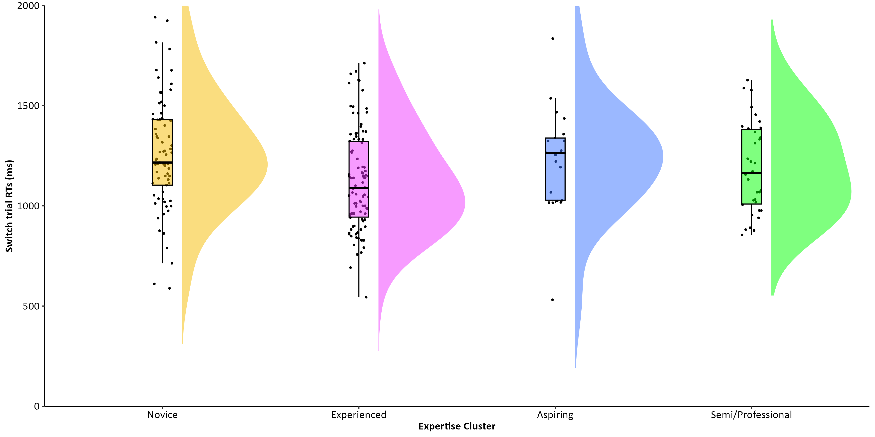
Switch Trial RTs
Strong evidence in favour of a main effect of expertise group on switch trial RTs: BF = 17.56
M = 591, SD = 112
Notes:
Novice - Exp BF = 80.92

Slide 9
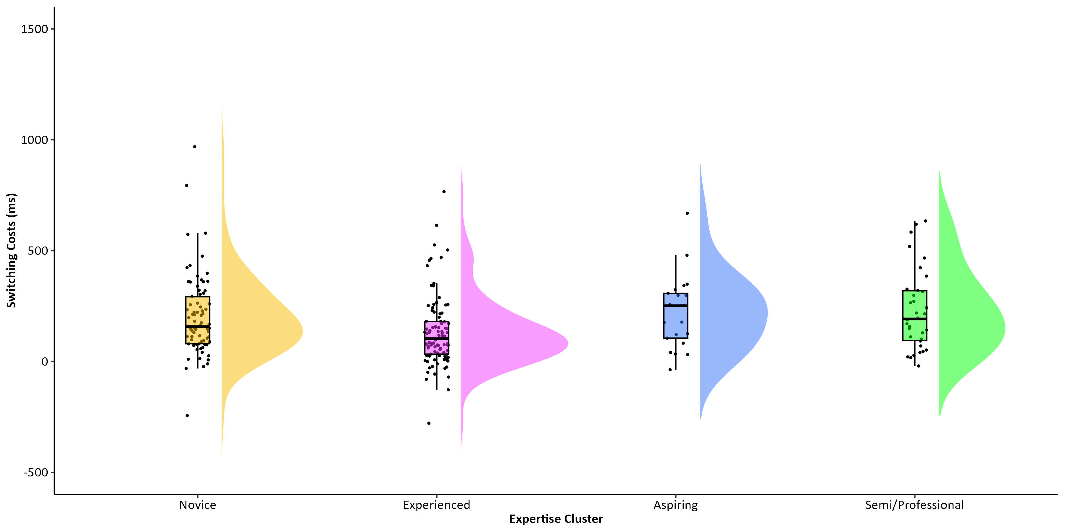
Switching Costs
Substantial evidence in favour of a main effect of expertise group on switching costs: BF = 7.37
M = 591, SD = 112
Notes:
Mixing Costs: RT performance cost of mixing two tasks (repetition trial RTs – single trial RTs)
Switching Costs: RT performance cost of switching from one task to another (switch trial RTs – repetition trial RTs)
Novice X Exp BF = 4.99
Exp X Pro BF = 9.76
Exp X Asp BF = 2.62

Slide 10
Drift-diffusion model (DDM)
1. Drift Rate (v)
information accumulation
2. Boundary Separation (a)
response caution
3. Non-decision time (t0)
other non-decisional processes
Green
Drift Rate (v)
Boundary Separation (a)
Blue
Stimuli Encoding
Decision Time
Response Execution
Non-decision time (t0)
Notes:
DDM parameters correspond to latent cognitive processes:
After the initial encoding of stimuli, for example, a shape that could be blue or green, there is a noisy period of evidence accumulation until the information is sufficiently clear.
The slope of information accumulation, known as drift rate (v), represents how efficiently stimuli information is processed. Once a decisional threshold is reached (i.e., if the shape is blue or green) then a response is executed.
The distance between the two choices reflects response caution, known as boundary separation (a) and indicates a possible speed-accuracy-trade-off. If the individual favours speed, their narrow boundary separation indicates low response caution whereas if they favour accuracy, their wide boundary reparation would indicate high response caution. A response is executed once a decision has been made (pressing a key).
The final component, non-decision time (t0) represents the time period of other processes which are not related to the decision itself such as stimuli encoding and response execution
The model provides additional insight into the underlying cognitive processes within a Choice RT Task, beyond that of RT and Accuracy Scores.

Slide 11
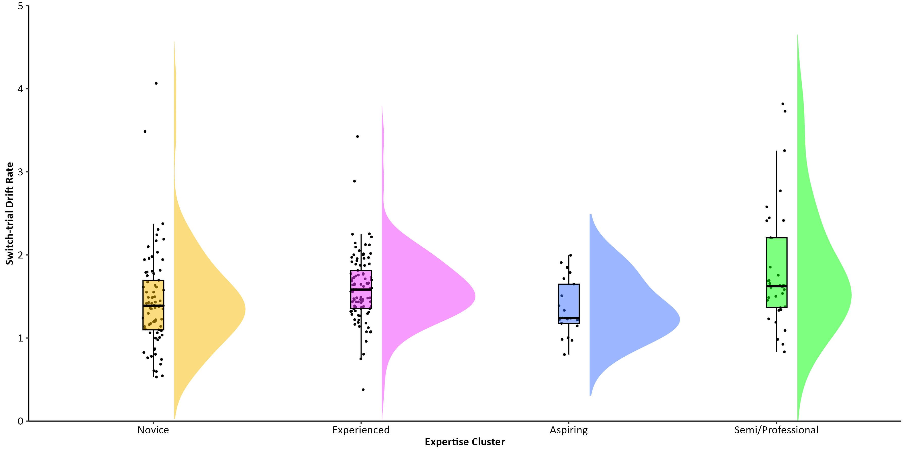
Drift rates (v): Switch Trials
Substantial evidence in favour of a main effect of expertise group on switch trial drift rates: BF = 9.07
(v)
M = 591, SD = 112
Notes:
Novice X Pro BF = 9.60
Asp X Pro BF = 5.45

Slide 12
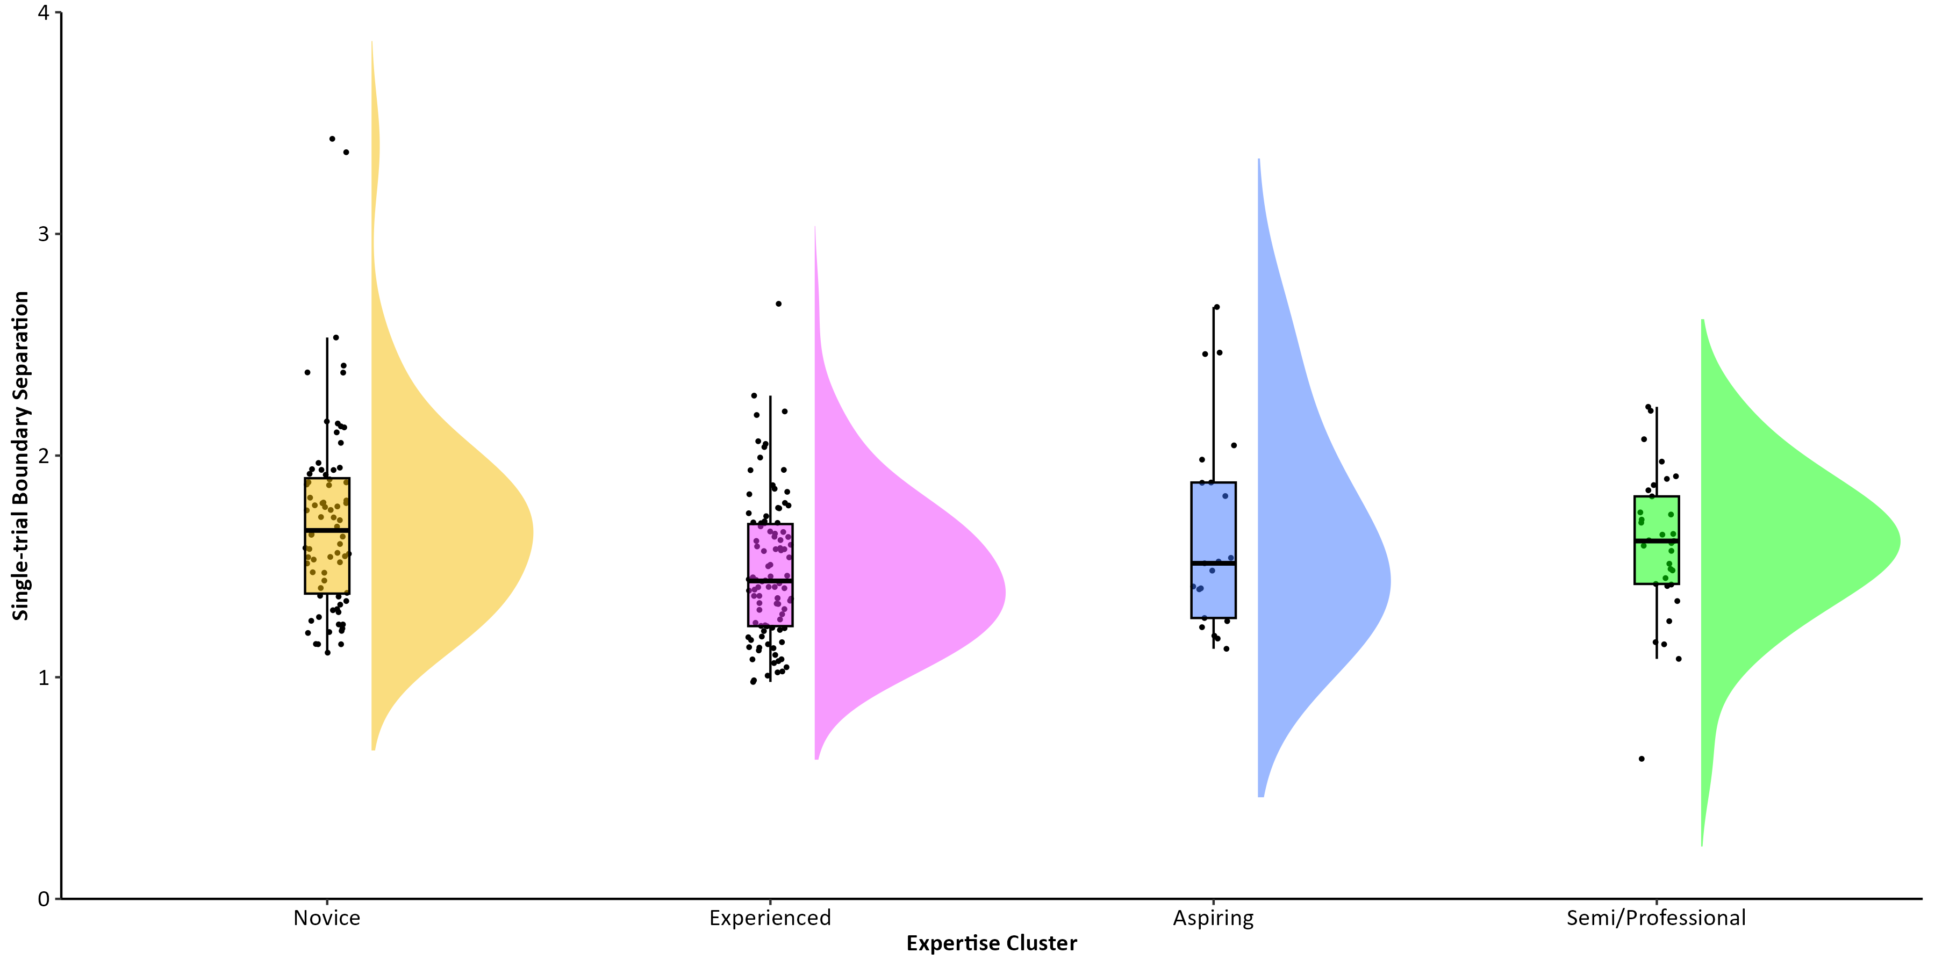
Boundary Separations (a): Single Trial
Ambiguous evidence in favour of a main effect of expertise group on single-rule block boundary separations: BF = 2.88
(a)
M = 591, SD = 112

Slide 13
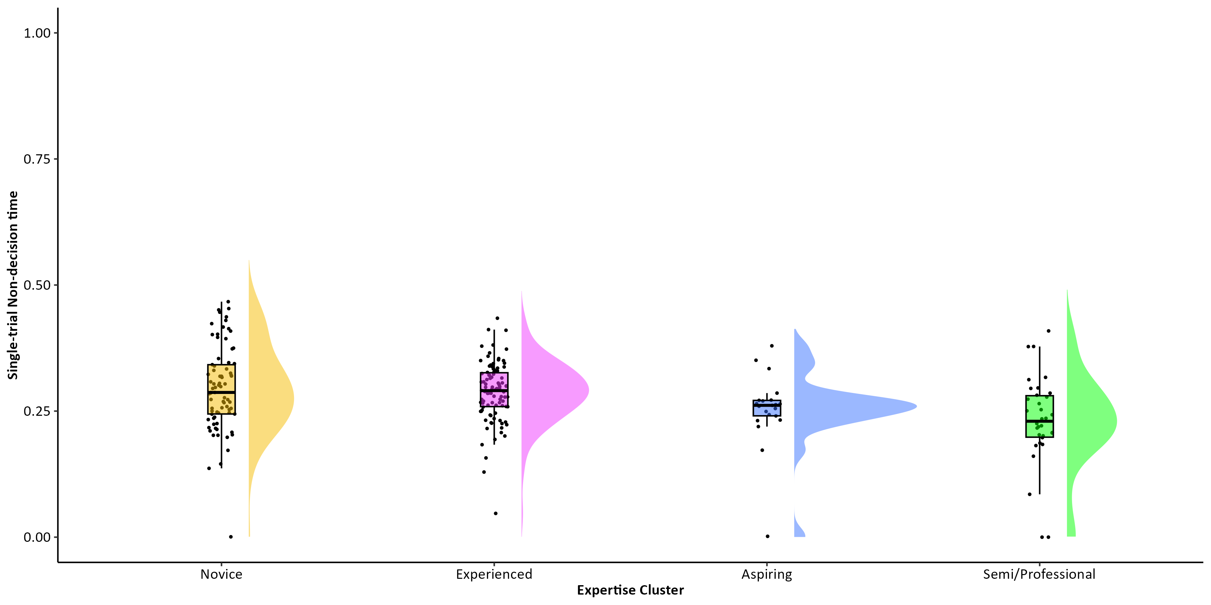
Non-decision times (t0): Single Trial
Decisive evidence in favour of a main effect of expertise group on single trial non-decision times: BF = 492.14
(t0)
M = 591, SD = 112
Notes:
Novice X Pro BF = 115.05
Exp X Pro BF = 914.27

Slide 14
Conclusions
CS expertise is a multi-dimensional construct that can be measured by a range of variables and k-means clustering.
CS expertise associated with greater processing speed performance, with no sacrifices in accuracy, but these advantages go beyond simple reaction times:
CS expertise associated with greater efficiency in information accumulation in tasks which require more cognitive flexibility
Associations are mostly related to non-decisional processes (encoding and response execution)
Video gaming as a potential avenue for cognitive plasticity in speeded decision-making

